Slide 1
Group 1
Bouhadan Imad, Dellafaille Lander, Mariën Levi, Pepermans Manu, Van de Mieroop Kevin

Slide 2
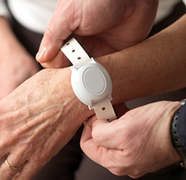
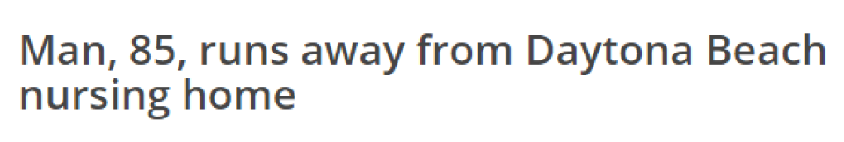
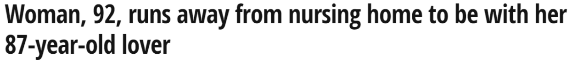
Introduction
Eldertrack
What is ElderTrack?
Is ElderTrack worth buying?
What can ElderTrack do for you?

Slide 3
Introduction
What can Eldertrack do for you?
Indoor localization (floor and room)
Outdoor localization (coördinates)
Cloud based monitoring platform

Slide 4
Buildup of the project
Outdoor
LoRaWAN
data
Back-end
DASH7
RSSI + DATA
Indoor
GPS
Parsing
Barometer
ThingsBoard.io
Temperature
Fingerprinting
e-Compass
Altitude

Slide 5
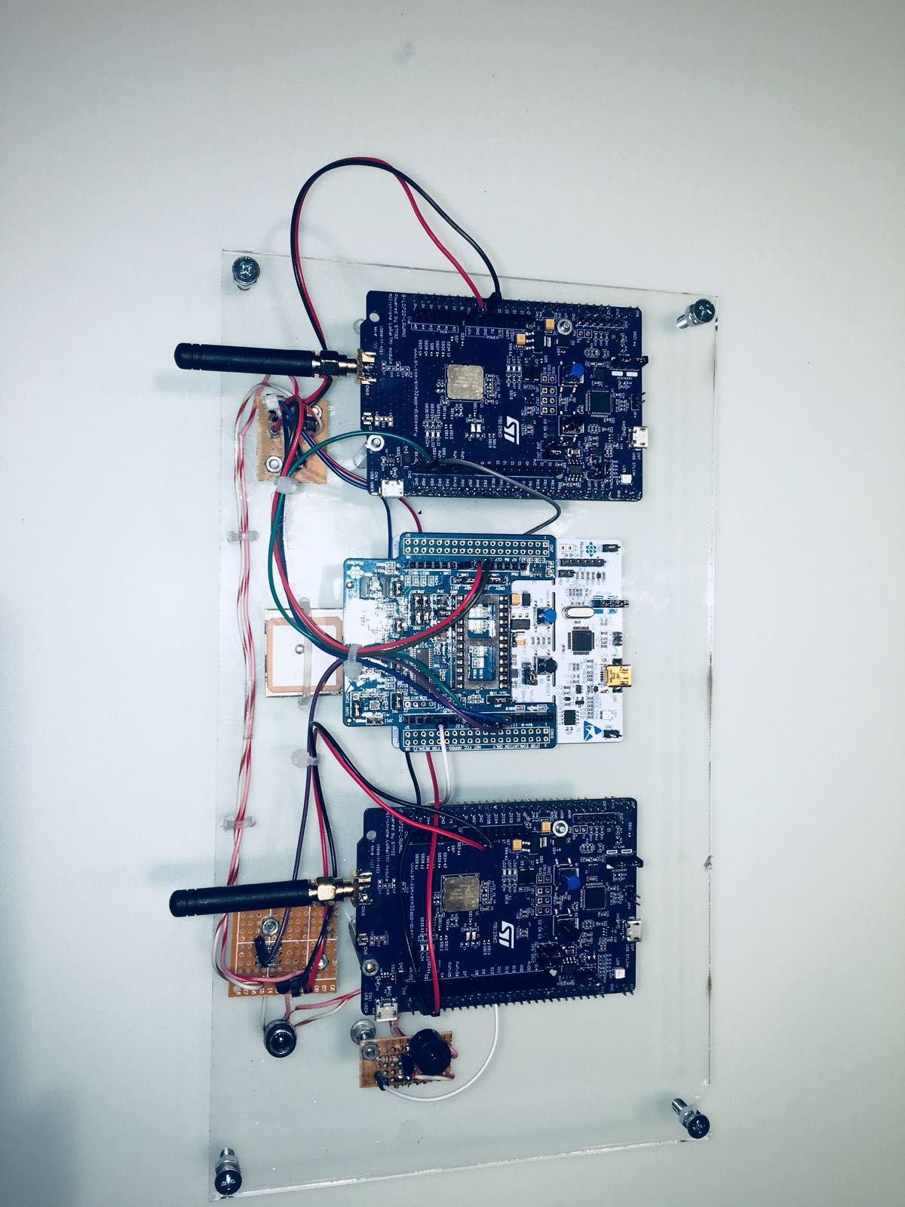
HARDWARE

Slide 6
Frontend
Back-end
Frontend
Parsing
Temperature
DASH7 (Data + RSSI)
Barometer
INDOOR
DASH7 (Downlink)
ThingsBoard.io
e-Compass
Control
Fingerprinting
LoRaWAN (DATA)
GPS
OUTDOOR

Slide 7
DASH7

Slide 8
Communication (INDOOR )
DASH7
Uplink: Sensordata + RSSI
Barometer and Temperature sensor
kNN
Downlink: Alarm when tracked person is outside
Listen for command
ALP Command: void DASH7Message(uint8_t data[], int lengthDash7)

Slide 9
SENSORS

Slide 10
sensors
X-NUCLEO-IKS01A2
X-NUCLEO-IKS01A2
Barometer
Temperature sensor
Accelerometer
Magnetometer
Altitude & Temperature
Ecompass

Slide 11
Acquiring sensor data
Barometer 11 Temperature 11 magnetometer 11 accelerometer
Read registers
Concatenate
Convert
Scale
Usable data

Slide 12
Altitude
Indoor
Use barometer and temperature
Initial: get air pressure from weather API and use as reference
Too many different weather models
Not 100% accurate
Could be used Training
Now: measure air pressure at startup and use as reference
Calculate difference in height, taking into account temperature and change in air pressure
Define levels

Slide 13
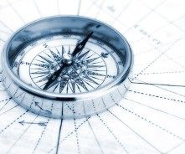
SENSOR Outdoor
Ecompass
Usage of the accelerometer and magnetometer data
Algorithm based on the DT0058 Design tip by ST
Gives the direction indoor where the person is heading

Slide 14
Implementation
Drivers for the LSM303AGR and LPS22HB
Drivers written for the LSM303AGR and the LPS22HB
Calibration (hard ironing) applied in the LSM303AGR driver
No configuration needed, sensors are init in lowest power possible
Ability to put the sensors in sleep and wake them up for a single shot measurement

Slide 15
Frontend
Back-end
Frontend
Parsing
Temperature
DASH7 (Data + RSSI)
Barometer
INDOOR
DASH7 (Downlink)
ThingsBoard.io
e-Compass
Control
Fingerprinting
LoRaWAN (DATA)
GPS
OUTDOOR

Slide 16
GPS

Slide 17
GPS (OUTDOORS)
NMEA commands
Initializing
GPGLL : Latitude, N/S, Longtitude, E/W, Time, Data valid
AT+SEND:2=“5117.1421,N,0000428.4897,E,230746.000,A,A*56”

Slide 18
lora

Slide 19
Communication (OUTDOORs)
LoRAWAN
B-L072Z-LRWAN1
Only activated when entering danger zone
GPS Data to gateway
AT Commands
ATZ
AT+JOIN
AT+NJS=?
AT+SEND when data comes in
Notes:
Check if connection between lora-module and nucleo board
NJS = network join status, zien of lora nw joined
ATZ = microcontroller reset

Slide 20
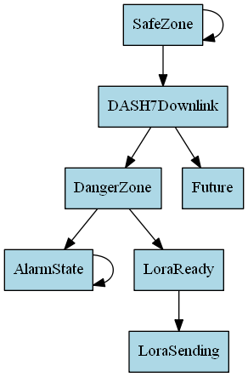
Control Unit
Finite State Machine (FSM)

Slide 21
Buildup of the project
Outdoor
LoRaWAN
data
Back-end
DASH7
RSSI + DATA
Indoor
GPS
Parsing
Barometer
ThingsBoard.io
Temperature
Fingerprinting
e-Compass
Altitude

Slide 22
Backend
Parsing
Subscribed to 3 MQTT topics:
/tb: Dash7 data
/loriot: LoRa data
/localisation: RSSI values for kNN
Publishing to ThingsBoard.io with ThingsBoard API and MQTT
Remote procedure call with ThingsBoard API

Slide 23
Backend
Parsing
Dash7 data is parsed through checking the first value:
“M”agnetometer information:
0-360 degrees -> changed to cardinal direction
“B”arometer information:
raw values from sensor -> changed to altitude
“O”K message
Dash7 RPC is received by node
“E”rror message
LoRaWAN is not joined on node
LoRa data is parsed through checking if GPS information is valid:
“A”ctive, GPS data is valid
change minutes to degrees and correct if GPS data is from Southern Hemisphere
kNN is calculated if RSSI values are received within one second form at least 3 gateways

Slide 24
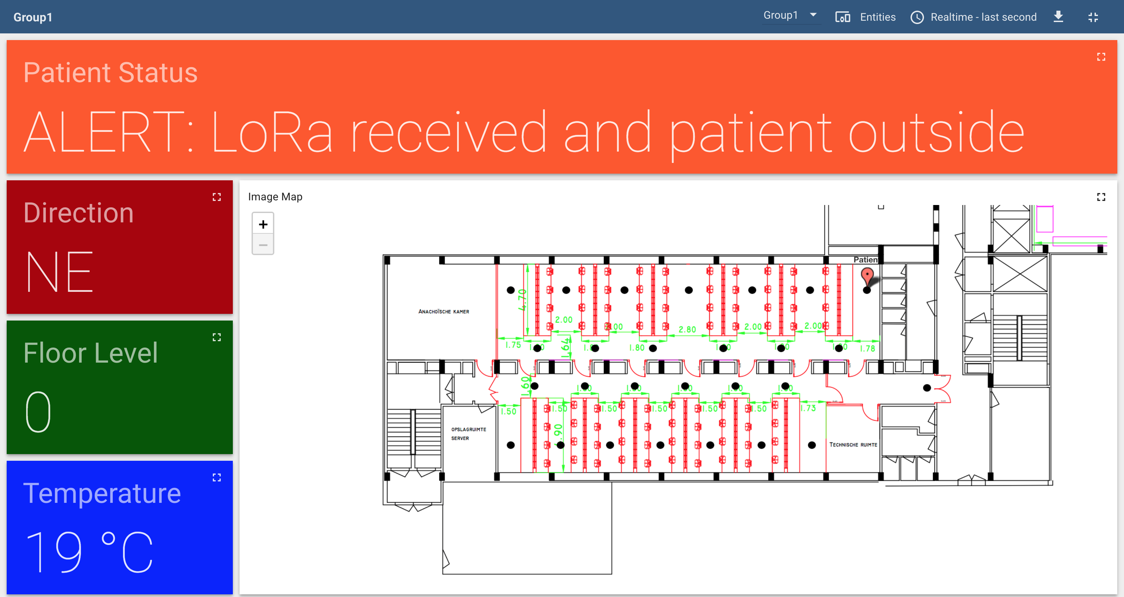
Backend
Thingsboard.IO

Slide 25
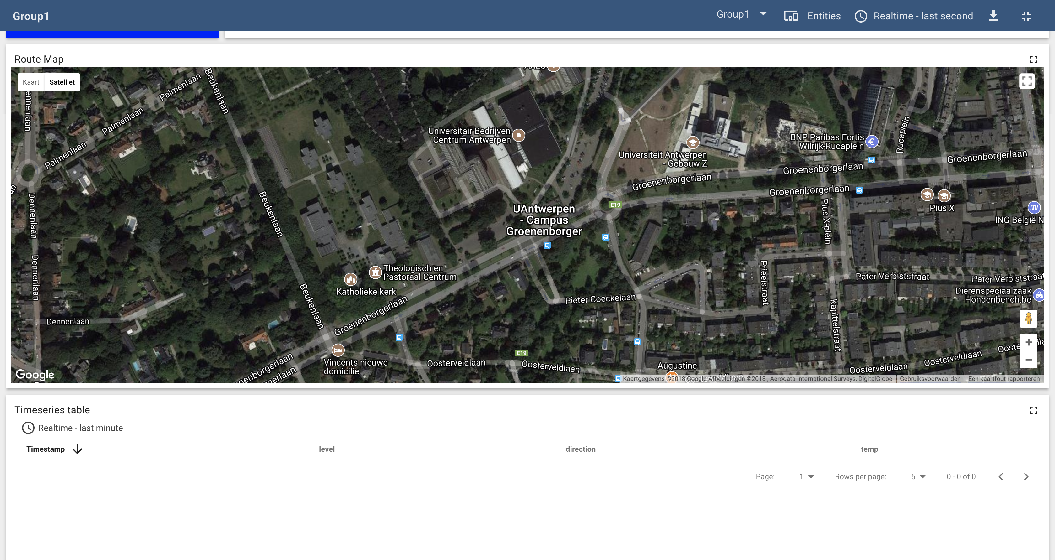
Backend
Thingsboard.IO

Slide 26
Fingerprinting
training
Define training locations 27
26 inside + 1 outside to detect danger zone
Collect measurements 20 per location
More measurements, higher accuracy
Set up database for comparison

Slide 27
Fingerprinting
operational phase
Receive Data
Calculate Distances
Find Neighbor
Vote on labels
2.2
2
2.4
1
3.1
1
3.5
Natasha Latysheva (2016). Implementing Your Own kNN using Python. https://www.kdnuggets.com/2016/01/implementing-your-own-knn-using-python.html

Slide 28
Fingerprinting
operational phase

Slide 29
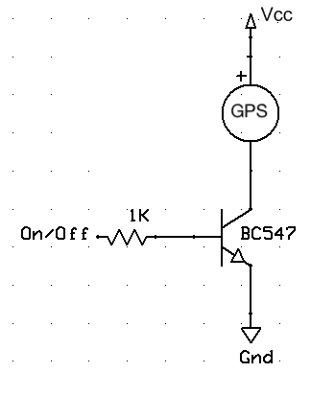
Energy consumption
Low power features
Small circuits to switch the pheripherals on and off:
GPS
Buzzer
Lora and Dash7
Sensors are init in sleep mode
Only wake up on certain times, pushing data and go back to sleep

Slide 30
Energy Consumption
Measured Energy consumption (NUCLEO + SENSORS)
Idle time
LPS22HB
Idle time
LSM303AGR

Slide 31
Energy Consumption
Measured Energy consumption (NUCLEO + SENSORS + DASH7)
Idle time
LPS22HB
DASH7
LSM303AGR
DASH7

Slide 32
Extras
Watchdog timer
Starts when main Nucleo board initializes
If no reset within window; MCU reset
Buzzer
Goes off when in alarm state
While waiting for GPS coordinates

Slide 33
Possible improvements
Only send DASH7 messages when movement is detected
Outdoor localization using height and ranging
Calculate height with reference pressure at sea level
Calculate distance from home using Lora (TOF, RTT)
Height + distance Use map to determine location
Put main module in sleep mode to reduce power consumption
System working on 3.3V instead of 5V
More measurements per point for kNN improvements
GPS hot start and power off when not sending

Slide 34
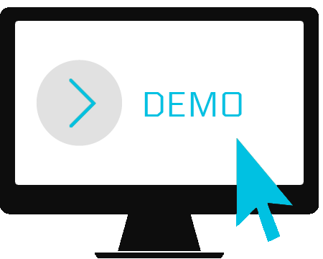
Demonstration

